Slide 1
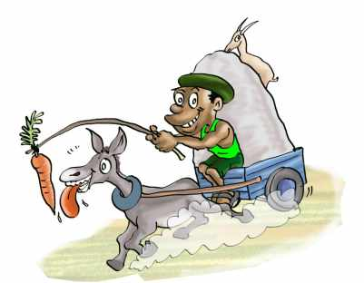
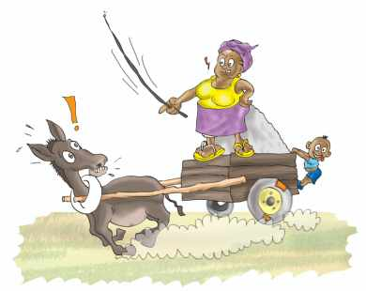
Water SectorTrust Fund
SOCIAL MARKETING
5. Improving Sanitation: Carrots & Sticks
people, place, product, price, participation, promotion, policy, programs, positioning, partnerships, poo, pee

Slide 2
UBSUP Social marketing: 6 key messages
Access to adequate sanitation is a human right
Benefits of improved sanitation (better toilets)
Advantages of the SafiSan toilets
Importance of using the toilet properly, keeping the toilet clean and in good condition
Importance of hand washing especially after using the toilet (to kill germs & reduce the risk of diseases)
Importance of emptying, transport & decentralised treatment (if applicable)

Slide 3
Carrots & Sticks
Carrot and Stick Approach (also "carrot or stick approach") is an idiom that refers to a policy of offering a combination of rewards and punishment to induce behavior
It is named in reference to a cart driver dangling a carrot in front of a mule and holding a stick behind it
The mule would move towards the carrot because it wants the reward of food, while also moving away from the stick behind it, since it does not want the punishment of pain, thus drawing the cart
Idiom: is a combination of words that has a figurative meaning, due to its common usage
Source: Wikipedia, keywords; Carrot and stick approach & idiom

Slide 4
Carrots & Sticks
What are our carrots?
The SafiSan toilets:
Are incentivised and, therefore, affordable
Are easy to use, clean and maintain
Do not smell
Are termite proof
Are solutions for areas with high water tables, rocky soils & sandy soils
Are equipped with an innovative hand washing facility
Produce a relatively harmless compost which can be treated locally
Have been approved by the County

Slide 5
Carrots & Sticks
What are our sticks?
Good sanitation (good toilets) is a human right!
Poor sanitation causes disease
The Public Health Act allows the Public Health Officer (PHO) to inspect dwellings and toilets and to act if the sanitation situation is not good
Local bylaws may stipulate specific sanitation requirements
Therefore, landlords and landladies have the obligation to provide their tenants with good sanitation
It is not allowed to dump sludge from toilets in the environment (drains, rivers, empty plots, etc.)

Slide 6
Sticks: Sanitation is a human right!
The Constitution (2010) says:
43. (1) Every person has the right—
  (a) to the highest attainable standard of health, which includes the right to health care services, including reproductive health care;
  (b) to accessible and adequate housing, and to reasonable standards of sanitation;
  (c) to be free from hunger, and to have adequate food of acceptable quality;
  (d) to clean and safe water in adequate quantities;

Slide 7
Sticks: Vision 2030
The Vision 2030 development blueprint states:
Water and Sanitation
Kenya is a water scarce country. The economic and social developments anticipated by Vision 2030 will require more high quality water supplies than at present.
The 2030 vision for water and sanitation is to ensure that improved water and sanitation are available and accessible to all.

Slide 8
Sticks: The Public Health Act
Under the Public Health Act, 242 - laws of Kenya, Section 118 (1) (b)(e) and (k)(n):
The Public Health Officer (PHO) has a right to inspect and supervise whether a premises or dwelling place is dirty or so verminous as to be, in the opinion of the medical officer of health, injurious or dangerous to health, or which is or are liable to favour the spread of infectious diseases like typhoid, cholera and diarrhoea
The sanitation provided should meet the satisfaction of the PHO

Slide 9
Sticks: The Public Health Act
If you don’t have good accessible sanitation the Public Health Officer is empowered by Public Health Act (Cap 242) to:
Institute a legal suite against the offender
May order the premises (household) as unfit for human occupation and close it down until the directed adjustments are carried out to his satisfaction
He may recommend you to be penalized for violating the right of others by paying some amount of money as per the Local Government Act

Slide 10
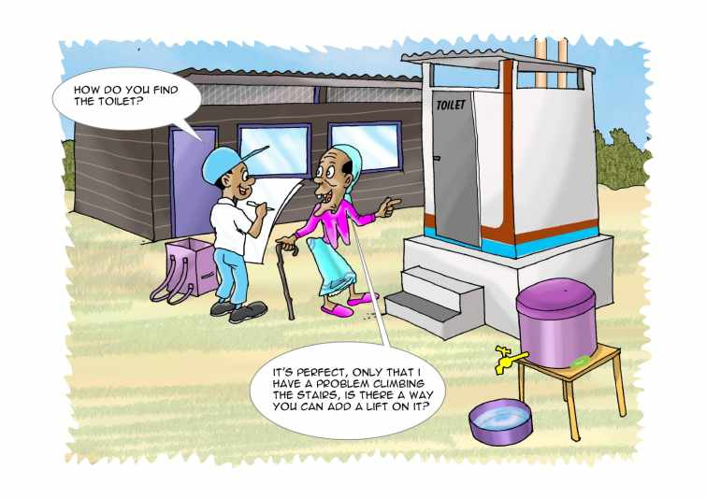
Thank You!

